Slide 1
Olist Store Analysis
E Commerce project
Group – 4
Kinjal
SHREEZA
Shivani
Ganesh
Mentor
Haseena mam - Coordinator

Slide 2
Introduction
The Olist Store Analysis Project aims to analyze customer purchasing patterns and payment statistics on an E- commerce platform.
This project covers several key performance indicators such as weekday vs weekend sales, payment statistics, delivery time, and customer behavior.
The analysis is based on nine CSV files, which are cleaned and manipulated to extract valuable insights.

Slide 3
Tools Behind this Analysis
Excel
Power Bi
Tableau
SQL

Slide 4

Data Modelling

Slide 5
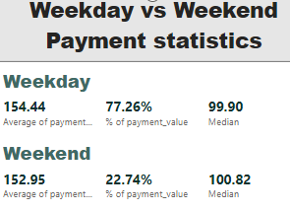
KPI 1 - Weekday Vs Weekend
The analysis of payment statistics based on Weekday vs weekend provides an understanding of the buying behavior of customers.
The analysis of this KPI can help Olist to improve their weekend sales and plan promotions accordingly.

Slide 6
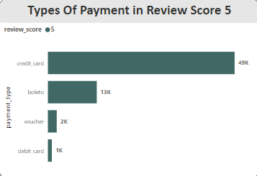
KPI 2 - No of orders with review score 5 and payment type as credit card
This KPI analyses the number of orders with a review score of 5 and payment type as credit card.
This helps in understanding customer satisfaction levels and payment preferences.
Olist can use this information to identify satisfied customers and encourage them to make repeat purchases.

Slide 7
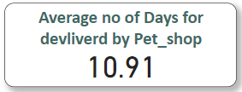
KPI 3 - Average delivery days for pet_shop
This KPI analyze the average number of days taken for order_delivered_customer_date for pet_shop.
It helps olist in identifying areas where they can improve their delivery time and maintain customer satisfaction.

Slide 8
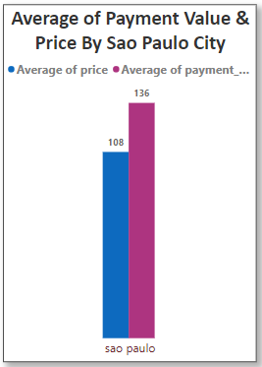
KPI 4 - Average Price and payment values from customers of Sao Paulo city
The analysis of average price and payment values from customers of sao Paulo city helps in understanding the spending patterns of customers in this region.
Identifying high value customers and creating targeted marketing campaigns.

Slide 9
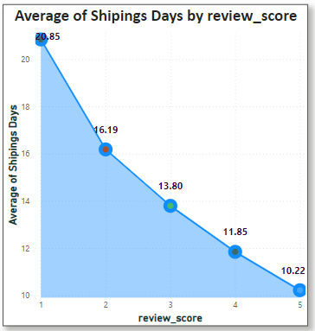
KPI 5 - Relationship between shipping days Vs review scores
This KPI analyses the relationship between shipping days and review scores.
It helps in understanding the impact of delivery time on customer satisfaction levels
Olist can use this information to optimize their logistics and improve their delivery time.

Slide 10
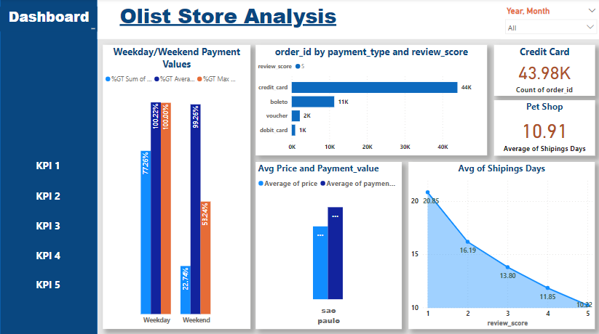
Olist Store Analysis Dashboard

Slide 11
Conclusion
The Olist Store Analysis project provides valuable insights into customer behavior and payment statistics.
The analysis of these KPIs help olist in identifying areas of improvement and creating targeted marketing campaigns.
As a Data Analyst, We have used Excel, Tableau, SQL and Power BI to clean and manipulate the dataset and create meaningful visualizations.
This project serves as a great example of how data analysis can help businesses make informed decisions.

Slide 12
Thank you

